Slide 1
Computer Vision and Image Processing
Tirgul 12
Key Points, Descriptors
& Moriya Bitton

Slide 2
Key Points

Slide 3
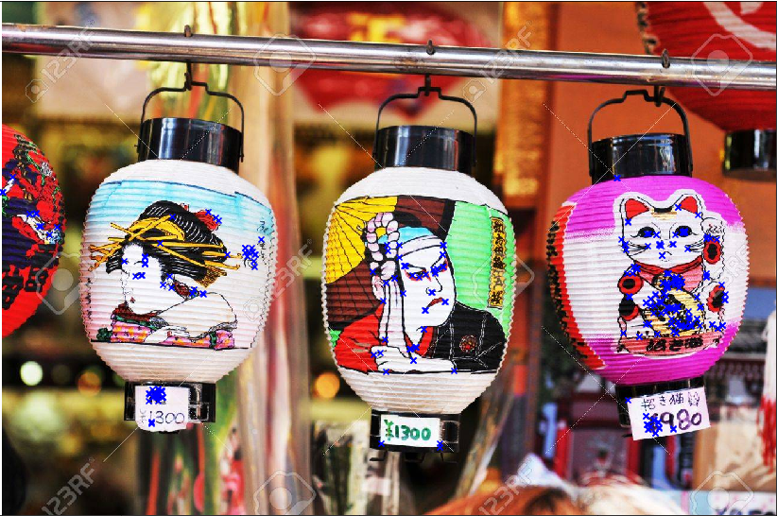
What is a ‘Key Point’?
Short answer:
A pixel (or a ‘pixel area’) such that it’s quite unique and easy to find.
(AKA ‘Interest Point’, ‘Corner’ and ‘Feature Point’)

Slide 4
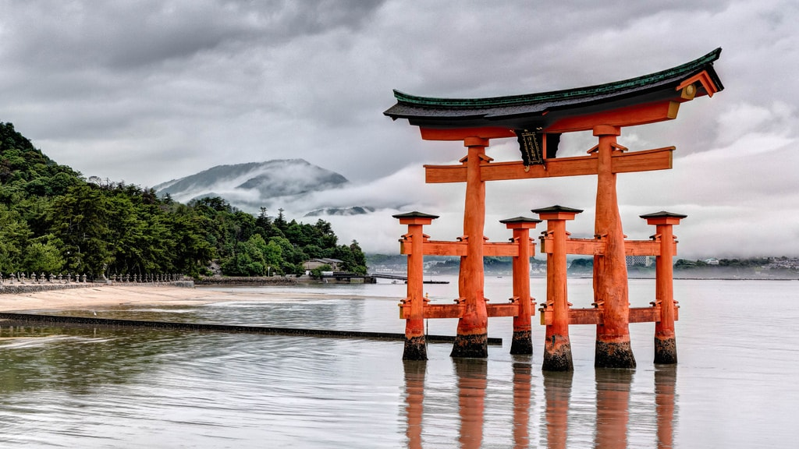

Why do we want them?
1. Large and complex motion detection

Slide 5
Why do we want them?
2. Image registration

Slide 6
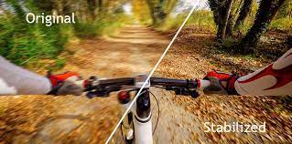
Why do we want them?
3. Video stabilation

Slide 7
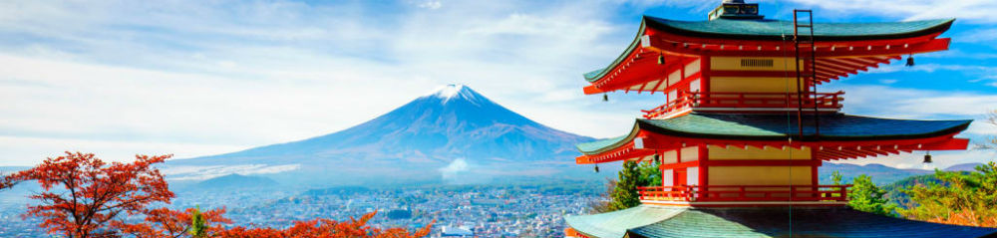
Why do we want them?
4. Panorama stitching
And many more...

Slide 8

What makes a ‘Key Point’ a good one?
KeyPoint

Slide 9
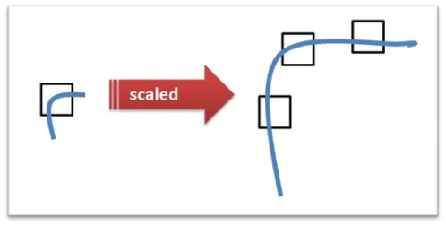
What makes a ‘Key Point’ a good one?
Easy to spot
Unique
Scale invariant
Rotation invariant
?

Slide 10
“Corners”- Why?
They are easy to find (naive solution is finding where lines intersect)
If the corner is ‘strong’ enough, scaling won’t harm it
Rotation does not change a the corners angle

Slide 11
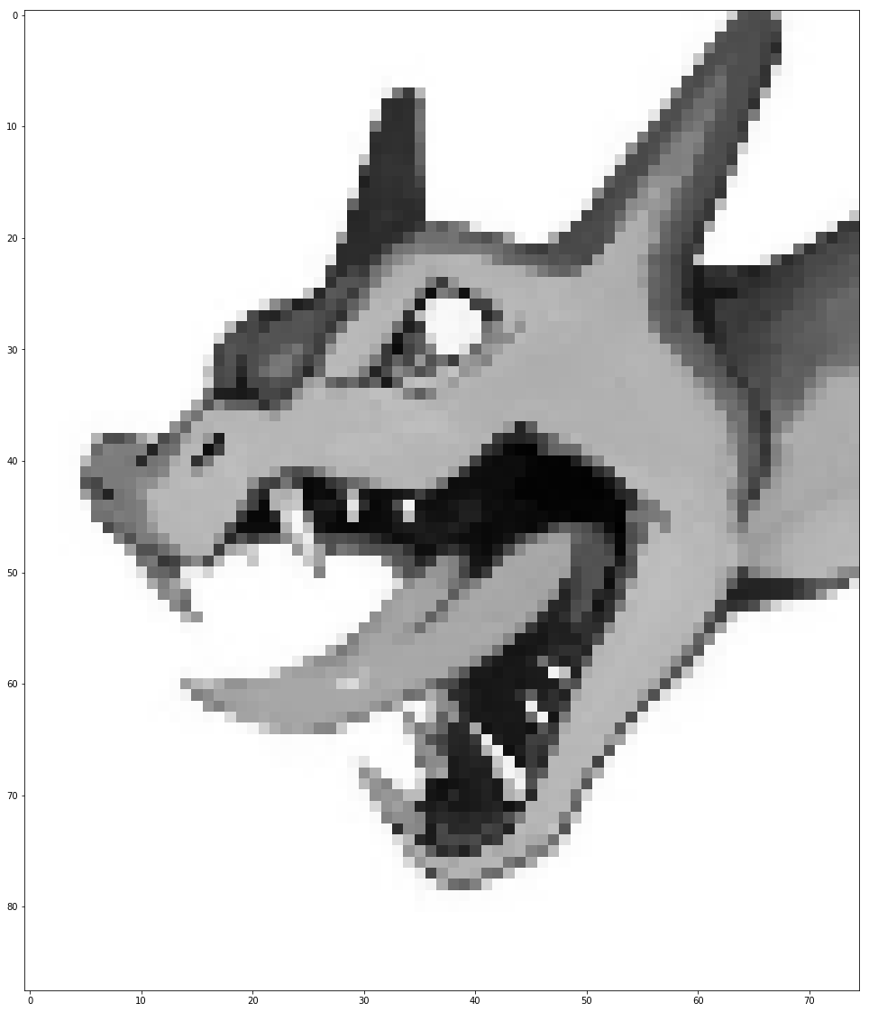
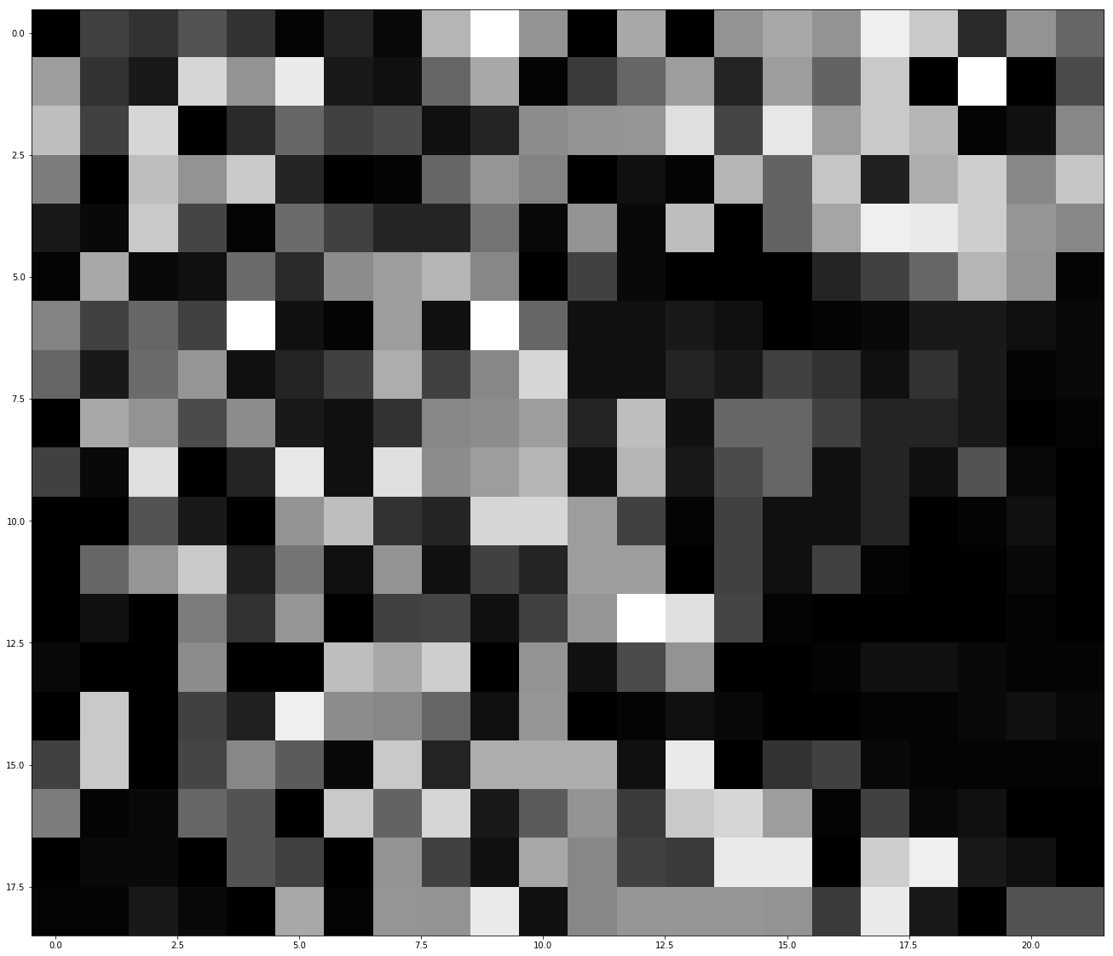
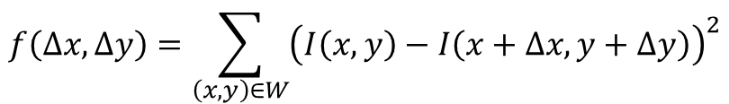
How do we find corners? Harris Corner Detector (1988)
For a given window, $W$, if we shift the window by $Δx,Δy$ the SSD will be:
$$f\left(Δx,Δy\right)=\sum_{\left(x,y\right)∈W}{{\left(I\left(x,y\right)−I\left(x+Δx,y+Δy\right)\right)}^{2}}$$

Slide 12


Harris Corner Detector (1988)
Taylor’s approximation:
$$f\left(x+u,y+v\right)≈f\left(x,y\right)+\frac{∂f}{∂x}⋅u+\frac{∂f}{∂y}⋅v$$
Giving us:
$$f\left(Δx,Δy\right)≈\sum_{\left(x,y\right)∈w}{{\left(I_{x}\left(x,y\right)Δx+I_{y}\left(x,y\right)Δy\right)}^{2}}$$

Slide 13


Harris Corner Detector (1988)
Now we formulate it as a matrix multiplication equation:
$$f\left(Δx,Δy\right)≈\left[\begin{matrix}Δx & Δy\end{matrix}\right]M\left[\begin{matrix}Δx \\ Δy\end{matrix}\right]$$
$$M=\sum_{\left(x,y\right)∈W}{\left[\begin{matrix}I_{x}^{2} & I_{x}I_{y} \\ I_{x}I_{y} & I_{y}^{2}\end{matrix}\right]}$$

Slide 14
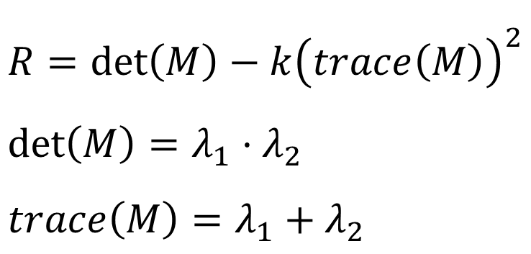
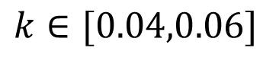
Harris Corner Detector (1988)
Harris response:
$$λ_{i} are the i eigenvalues of M, where λ_{1}≥λ_{2}≥…λ_{n}$$
$$R=\det\left(M\right)−k{\left(trace\left(M\right)\right)}^{2} \\ \det\left(M\right)=λ_{1}⋅λ_{2} \\ trace\left(M\right)=λ_{1}+λ_{2}$$
$$k∈[0.04,0.06]$$

Slide 15
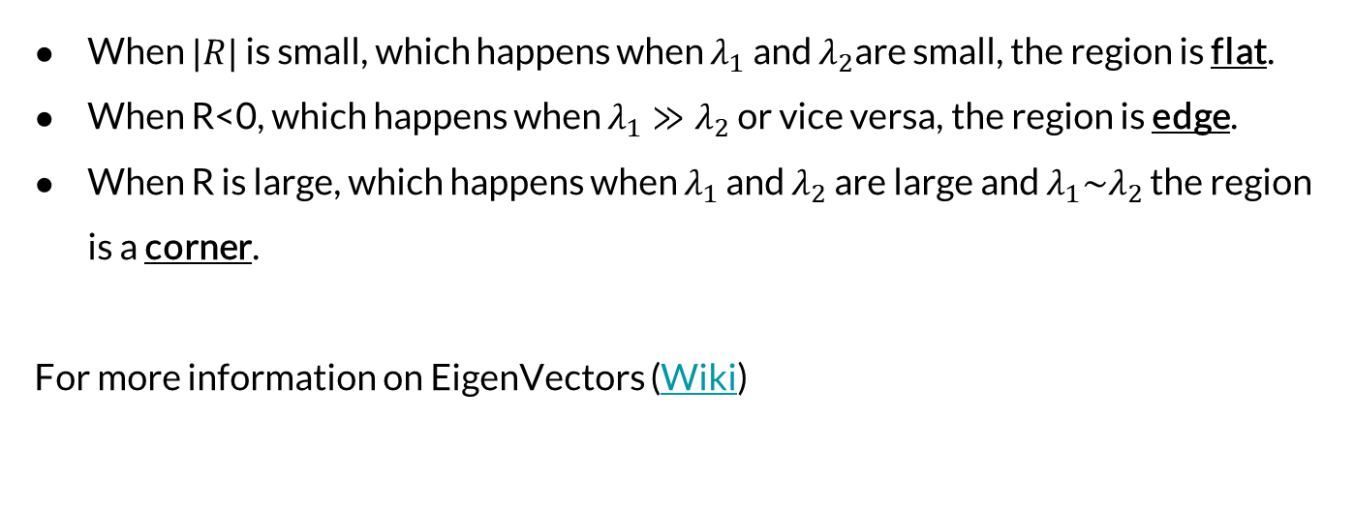
Harris Corner Detector (1988)
When $|R|$ is small, which happens when $λ_{1}$ and $λ_{2}$are small, the region is flat.
When R<0, which happens when $λ_{1}≫λ_{2}$ or vice versa, the region is edge.
When R is large, which happens when $λ_{1}$ and $λ_{2}$ are large and $λ_{1}\sim λ_{2}$ the region is a corner.
For more information on EigenVectors (Wiki)

Slide 16
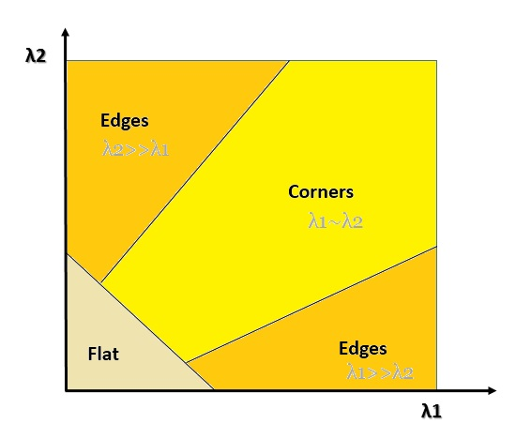

Slide 17
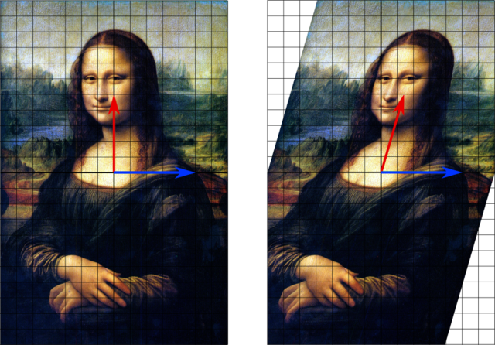
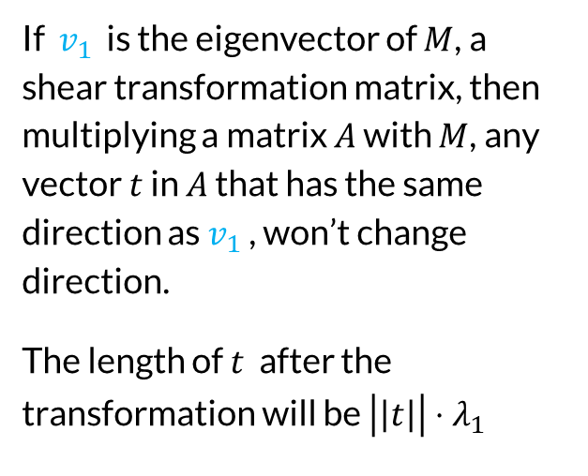
Eigenvalue/vector explanation
If $v_{1}$ is the eigenvector of $M$, a shear transformation matrix, then multiplying a matrix $A$ with $M$, any vector $t$ in $A$ that has the same direction as $v_{1}$ , won’t change direction.
The length of $t$ after the transformation will be $\left|\left|t\right|\right|⋅λ_{1}$

Slide 18
Eigenvalue/vector explanation
In short: Eigenvectors are the direction that the transformation matrix is transforming.
Eigenvalues is how much they are changing in that direction

Slide 19
Descriptors

Slide 20
We found keypoints, but how do we ‘match’ the keypoints?
?

Slide 21
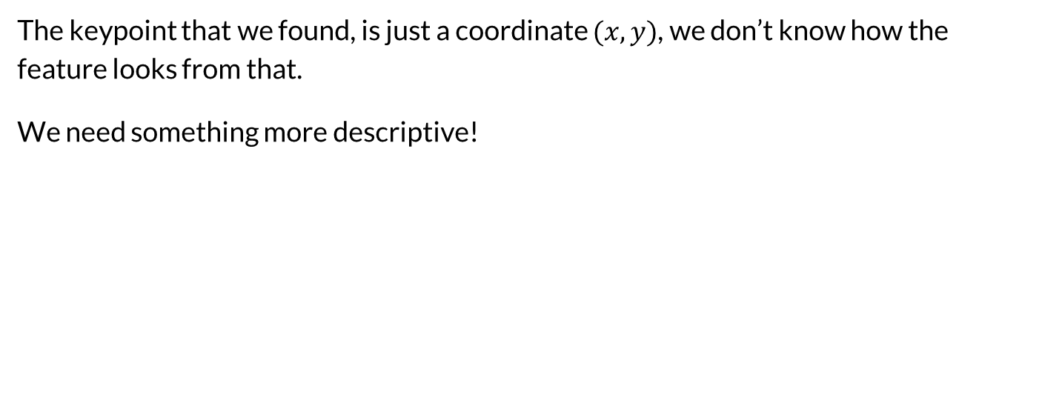
Descriptors
The keypoint that we found, is just a coordinate $(x,y)$, we don’t know how the feature looks from that.
We need something more descriptive!

Slide 22
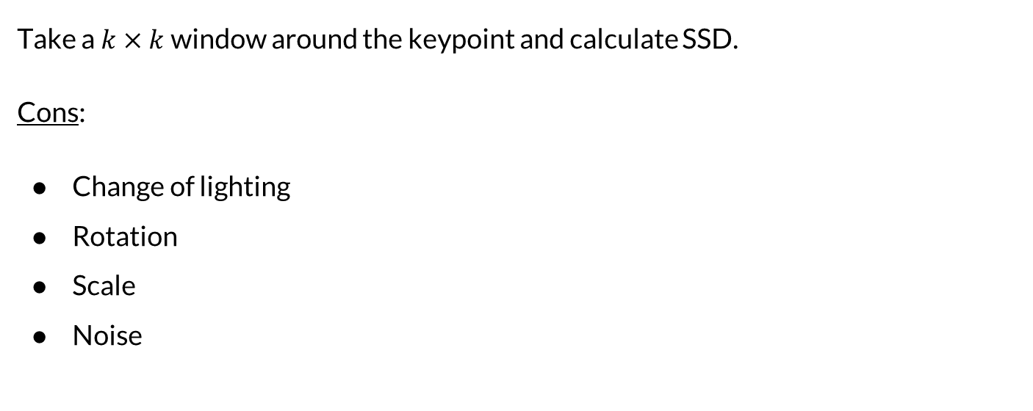
Naive descriptor
Take a $k×k$window around the keypoint and calculate SSD.
Cons:
Change of lighting
Rotation
Scale
Noise

Slide 23
SIFT – Scale Invariant Feature Transformation (1999)

Slide 24
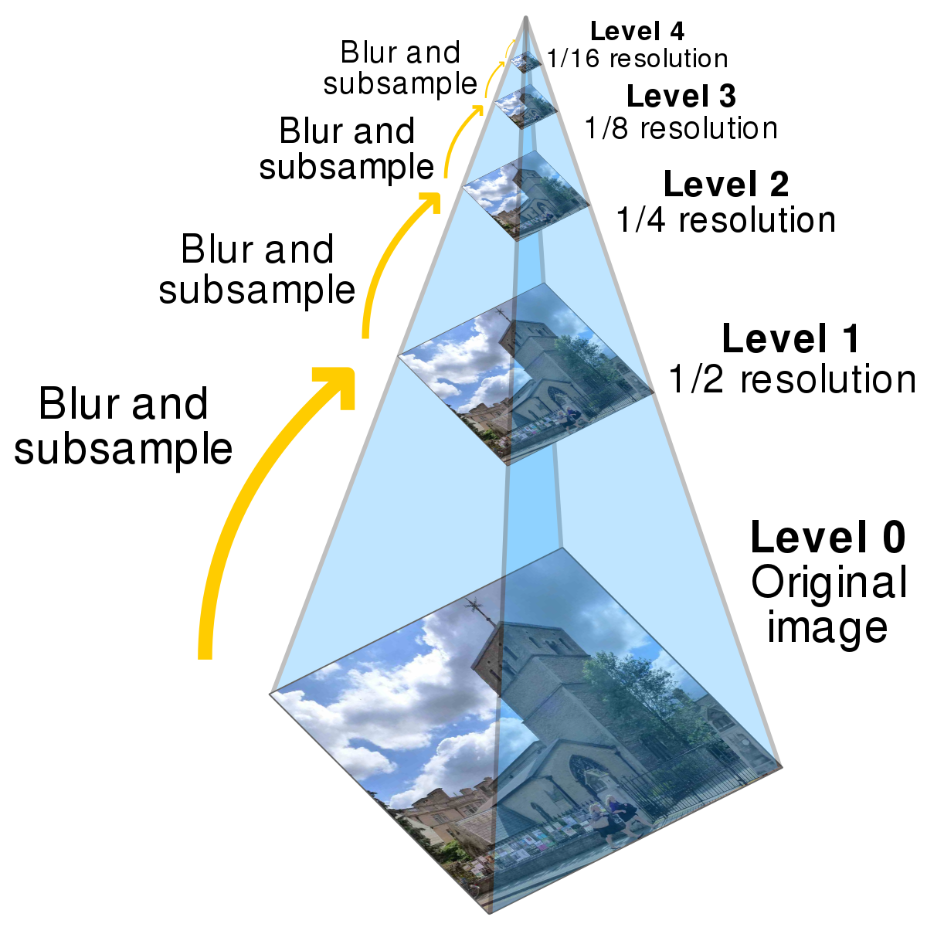
Scale
Scan the image at different scales (pyramid) and scale each patch to the same size.

Slide 25
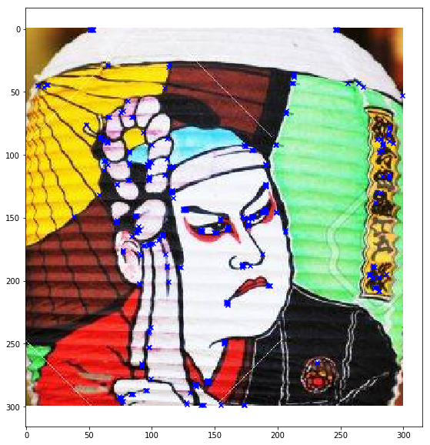
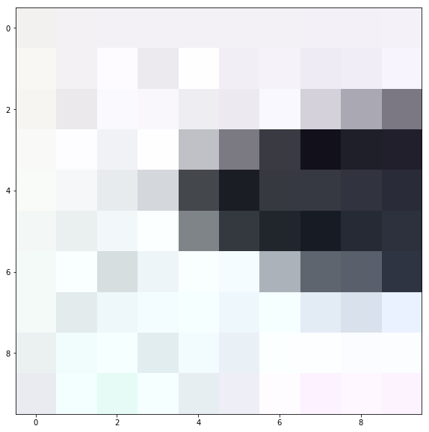
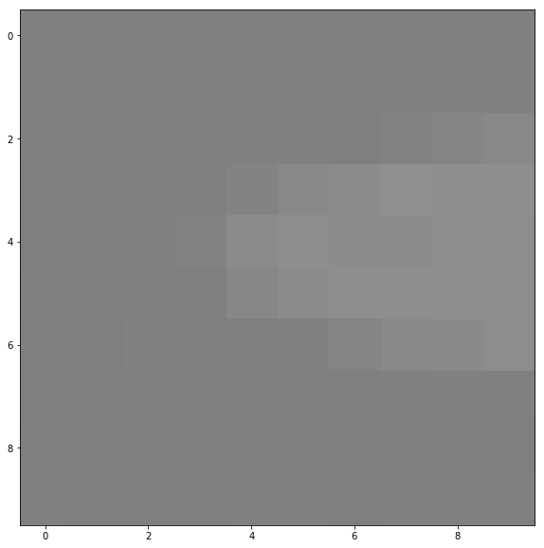
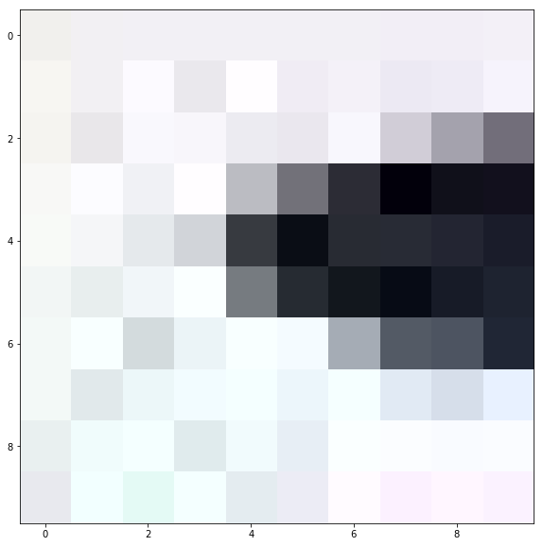
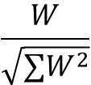
Lighting and Noise
Normalize the descriptor
Use the gradient image instead of the intensity/color image
$$\frac{W}{\sqrt{∑W^{2}}}$$
Diff

Slide 26
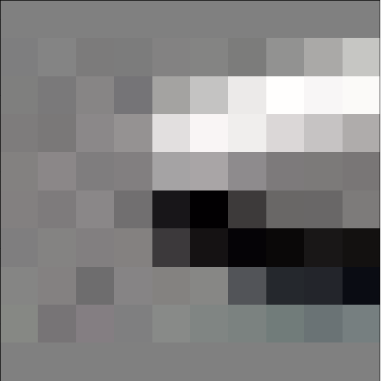
Lighting
Normalize the descriptor
Use the gradient image instead of the intensity(gray-scale) image

Slide 27
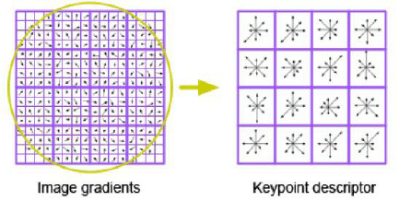
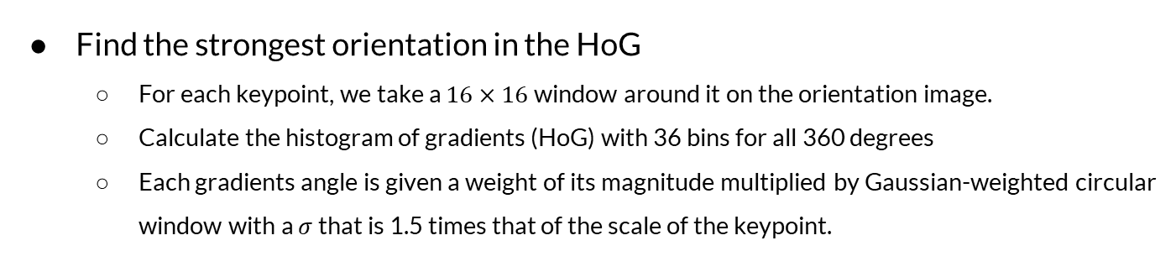
Rotation
Find the strongest orientation in the HoG
For each keypoint, we take a $16×16$window around it on the orientation image.
Calculate the histogram of gradients (HoG) with 36 bins for all 360 degrees
Each gradients angle is given a weight of its magnitude multiplied by Gaussian-weighted circular window with a $σ$that is 1.5 times that of the scale of the keypoint.

Slide 28
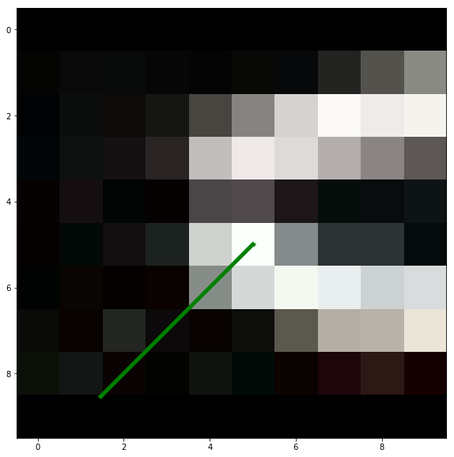
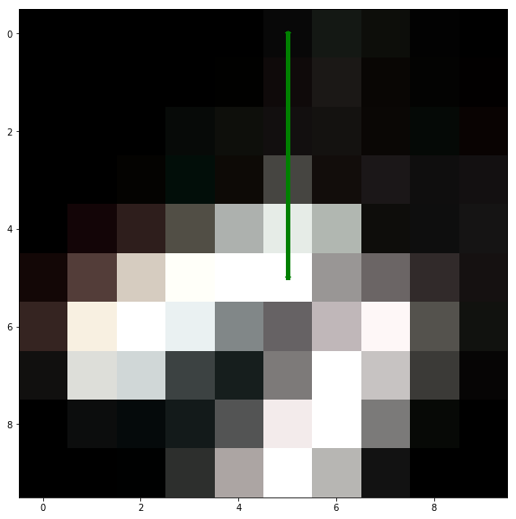
Rotation
Find the strongest orientation in the HoG
Rotate the window by that gradient angle
Actually just add the rotation degree to all the gradients

Slide 29
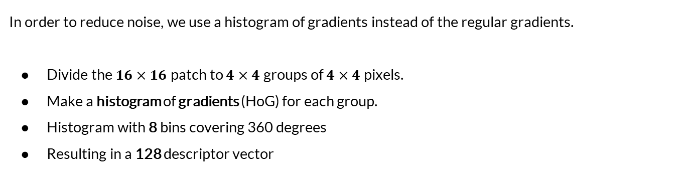
Noise + Distortion
In order to reduce noise, we use a histogram of gradients instead of the regular gradients.
Divide the $16×16$ patch to $4×4$ groups of $4×4$ pixels.
Make a histogram of gradients (HoG) for each group.
Histogram with 8 bins covering 360 degrees
Resulting in a 128 descriptor vector

Slide 30
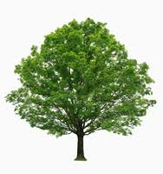
Noise + Distortion
The histogram and quantization, help with the noisy input and small distortion caused by different view angles.

Slide 31
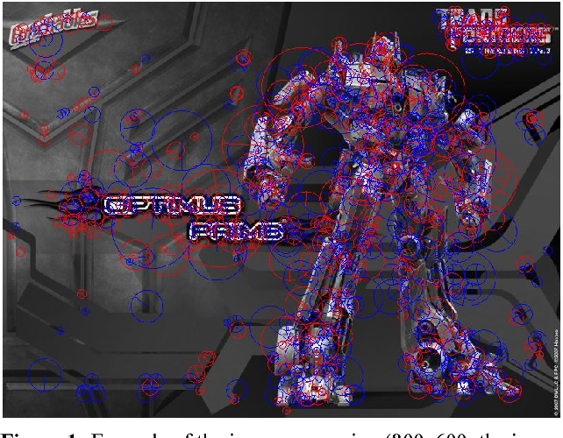
SIFT

